Slide 1

Bamboo Mobile Health Group 2
Ted Presley, David Helms, Franco Lamping, Michael Lambeth, Maxim Litvinov, Jeff Brown

Slide 2
Our Project
“Create a data visualization dashboard”
Take data from Google spreadsheet and visualize it
Make it simple
Make it available from any browser

Slide 3
Data
4 Categories
Pain
Fatigue
Mobility
Brain fog
6 Intensity levels
0,1,2,3,4,5

Slide 4
Why is this useful?
Doctors can see use this data to help track patient’s symptoms
~90 day history, average length between doctor visits
More reliable way of tracking data than relying on patient’s memory

Slide 5
Work done so far
Heatmap Calendar working using d3.js, javascript, HTML, CSS
Javascript made to reliably get json data from a Google spreadsheet

Slide 6
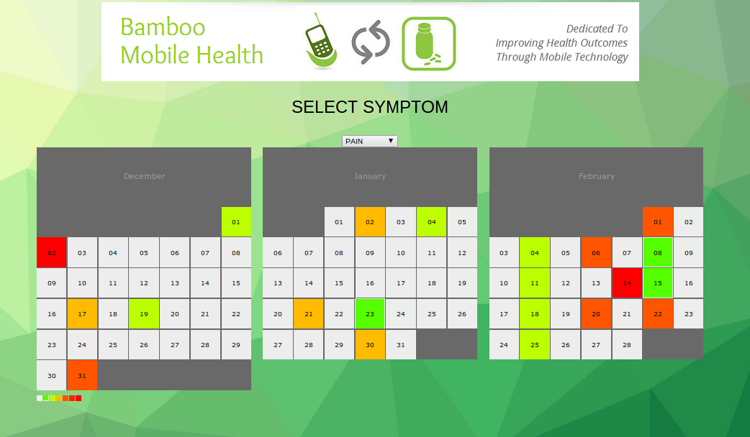
Work done so far

Slide 7
Questions?

